Slide 1

AI AGENT OLYMPICS — MILAN AI WEEK 2026
VERA
VITAL EARLY RISK ADVISOR
TRACK: COLLABORATIVE AGENT SWARMS
Powered by Google Gemini | Deployed on Vultr

Slide 2
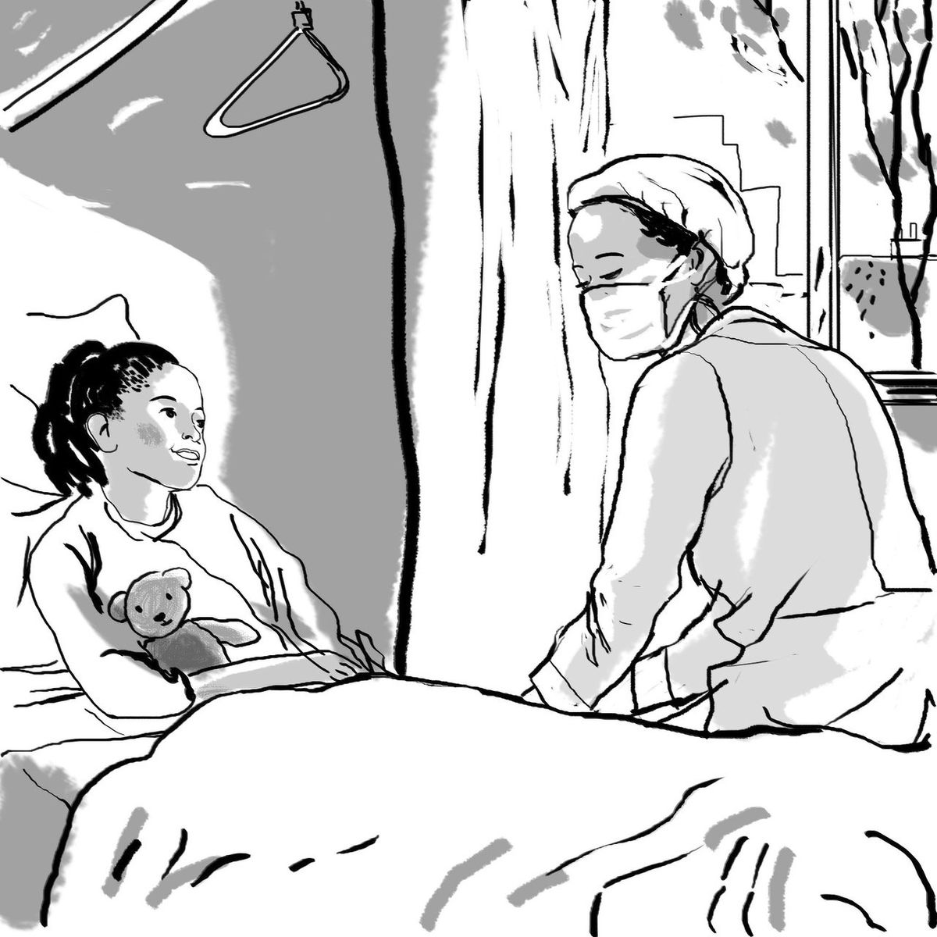
VERA
600 Million Women Are Being Ignored
600M
women worldwide skip cancer screenings every single year
70%
of cervical cancer cases in India detected at Stage 3 or 4 — when survival odds drop sharply
THE BARRIERS ARE NOT MEDICAL
■ No personalized understanding of their own risk
■ Stigma and lack of family support
■ Unawareness of free government schemes
■ No guidance in their own language
■ No one following up
Source: WHO, India Ministry of Health
02

Slide 3
VERA
The Screening Gap — A Silent Crisis
PRIMARY TARGET
SECONDARY TARGET
OUT OF SCOPE V1
Women 25–60
Drop-off Re-engagement
Post-Diagnosis
India and globally, with limited prior cancer screening history. 8 conversational questions replace intimidating medical forms.
Women who had one screening but fell through the cracks. VERA's Companion Agent brings them back.
Men's health, clinical decision support for providers, EHR integration, live doctor consultation.
THE VERA JOURNEY
Open VERA
in your language
8 Questions
conversational
Risk Score
+ timeline
Schemes
+ clinics
Companion
follows up
She leaves knowing her risk, her options, and her next step — in under 5 minutes.
03

Slide 4
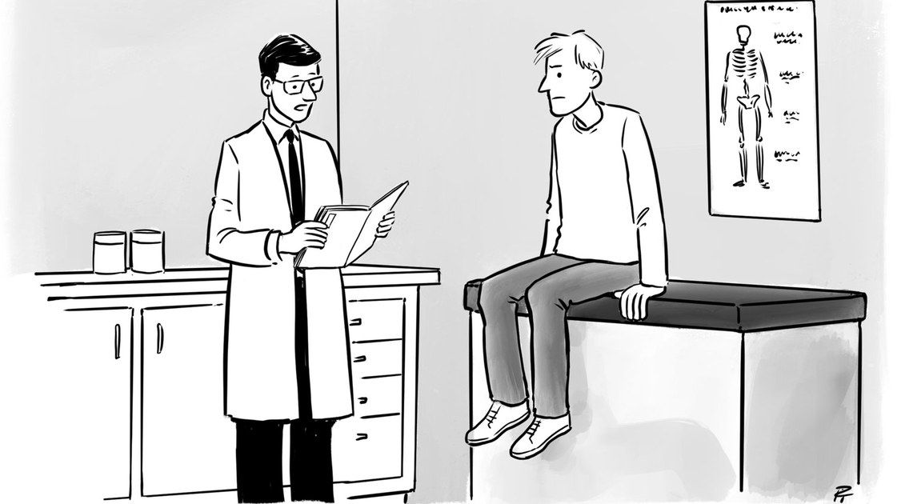
01
THE SOLUTION
Four Agents. One Mission.
Catching cancer risk before it becomes a crisis.
Risk Profiler
Care Navigator
Records Explainer
Companion

Slide 5
VERA
Meet VERA — Your Cancer Risk Companion
VERA = Vital Early Risk Advisor
FOUR SPECIALIZED AGENTS
Risk Profiler
Scores cancer risk from your profile using MedGemma
"Vera" means Truth in Latin.
Not a symptom checker. Not a generic health app. A focused system that catches cancer risk before it becomes a crisis.
VERA is for everyone — any age, any gender, any location.
Care Navigator
Finds specialists, government schemes, screening camps
Records Explainer
Reads lab reports and MRIs, explains in plain language
VERA'S VOICE
"I'm here to understand you, not to judge."
Warm, unhurried, never clinical or alarming.
Companion
Proactive check-ins, reminders, persistent health timeline
05

Slide 6
VERA
AGENT 1
Risk Profiler
Transforms a 2-minute conversation into a personalized cancer risk fingerprint. Replaces fear and confusion with clarity.
RISK OUTPUT
MODERATE RISK
8 CONVERSATIONAL QUESTIONS
# | Question | Captures
1 | How old are you? | Age-based risk
2 | Family history of cancer? | Hereditary risk
3 | When was your last screening? | Screening gap
4 | Received HPV vaccine? | HPV risk
5 | Do you smoke? | Lifestyle risk
6 | Where do you live? | Scheme + clinic match
7 | Any recent symptoms? | Urgency flag
8 | Preferred language? | Multilingual routing
■ Cancer types flagged: Cervical, Breast
■ Screening overdue by: 5 years
■ Family history: Mother — breast cancer
■ Clinical reasoning provided by MedGemma
POWERED BY
Gemini 2.0 Flash — conversational flow
MedGemma 27B — clinical risk scoring
Reconciler mode: Re-runs when new clinical signals arrive from uploaded reports.
06

Slide 7
VERA
AGENT 2
Care Navigator
Removes cost barriers by matching users to free government schemes and nearest screening facilities.
GOVERNMENT SCHEMES
Location-Aware Matching
🇮🇳
NHS
UK — national screening
Ayushman Bharat
India — free screening
Gemini 2.0 Flash powers location-aware scheme research, clinic identification, and eligibility summarization — all in the user's preferred language.
NHIA
Ghana — health insurance
+ Add any country
Scheme data is the only country-specific layer
"Why this matches you"
Personalized explanation for every scheme recommendation
OUTPUT FOR USER
■ Scheme cards with eligibility in plain language
■ Clinic tiles: 3 nearest, sorted by distance
■ CTAs: "Book Now" / "Call to Schedule" / "Walk-in Available"
07

Slide 8
VERA
AGENT 3
Records Explainer
Replaces fear of the unknown with understanding. Reads uploaded lab reports and MRIs — explains in plain language.
CRITICAL FEEDBACK LOOP
Personalized to Risk & Language
Extracts structured clinical signals from reports → feeds back into Agent 1 (Risk Profiler) → re-scores risk automatically. This is the emergent capability.
1. Risk profile: cervical concern + Hindi
2. Select: Pap smear video + early detection
3. Gemini generates personalized intro
4. Assemble: intro + video + text summary
5. Output: video player + summary below
EDUCATION CONTENT LIBRARY
Topic | Duration | Languages
Breast Self-Examination guide | 60s | EN, HI, TA
Pap smear: what to expect | 75s | EN, HI, TA
Mammogram: the procedure | 60s | EN, HI, TA
Why early detection saves lives | 45s | EN, HI, TA
Powered by Gemini — script generation, translation, personalization
08

Slide 9
VERA
AGENT 4
Companion
The persistent, warm presence that follows up — so no one falls through the cracks after their first VERA interaction.
SAMPLE FOLLOW-UP PLAN
Your VERA Follow-Up Plan
✓ This week: Call AIIMS Delhi to confirm your free Pap smear
📞 +91-11-26588500
✓ May 18: Your screening camp date at AIIMS Delhi
✓ June 12: VERA check-in — How did it go?
✓ Yearly: Reminder each May for cervical screening
PERSISTENT MEMORY
Session stored with session_id → User returns → cookie loads profile → Gemini greets by name and recalls last interaction.
"Hi Priya, last time your risk was Moderate. How did the clinic visit go?"
WHAT COMPANION DOES
Follow-up Plan
Specific dates, actions, locations
Reminders
1 week, 1 month, 3 months, yearly
Family Message
Warm, culturally appropriate draft
Health Timeline
Persistent record across sessions
Powered by Gemini — multilingual generation + memory summarization
09

Slide 10
VERA
The Agent Collaboration Architecture
Sequential pipeline with persistent Companion Agent layer — built for Collaborative Agent Swarms
Risk Profiler
Scores cancer risk
Care Navigator
Finds schemes + clinics
Records Explainer
Reads lab reports
clinical signals
Companion Agent — ALWAYS ACTIVE
Holds session state, consulted at every phase, persistent memory across sessions
The Emergent Capability: When Records Explainer finds new clinical signals → feeds back to Risk Profiler → re-scores risk.
The whole is greater than the sum of parts. No single agent can achieve VERA's mission alone.
10

Slide 11
VERA
The Technology Stack
Layer | Technology | Why It Matters
Frontend | Next.js 16 + Tailwind CSS | Mobile-first, responsive
Backend | FastAPI (Python, async) | High-performance API
Database | PostgreSQL 16 + pgvector | Structured + vector search
AI Models | Gemini 2.0 Flash + MedGemma | Speed + medical accuracy
Infrastructure | Docker + Vultr | One-command deploy
ARCHITECTURE HIGHLIGHTS
■ Async FastAPI — non-blocking agent orchestration
■ pgvector — semantic search for scheme matching
■ Shared state — PostgreSQL session store
■ MedGemma 27B — Google's medical AI, not generic LLM
■ Gemini Flash — <3s multilingual responses
■ Docker Compose — one command, entire stack
■ Mobile responsive — primary access is mobile
■ High contrast — accessibility built-in
■ Hardcoded fallbacks — demo never crashes
KEY PERFORMANCE TARGETS
<3s
100%
3
Response latency per agent step
Demo reliability target — zero crashes
Languages at launch: EN, HI, TA
11

Slide 12
VERA
The VERA User Experience
Every screen designed for warmth, clarity, and action — multilingual by design.
LANDING
CHAT
RISK DASHBOARD
SCHEMES
COMPANION
VERA
Your cancer risk companion
💬 Conversational risk assessment
🌐 Multilingual support
📌 Free scheme matching
[ Talk to VERA ]
VERA: Hi, I'm VERA. What's your name?
You: Priya
VERA: How old are you, Priya?
You: 38
VERA: When was your last screening?
[ _____________ ] [Send]
Your Risk Profile
MODERATE
■ Cervical risk flagged
■ Breast risk flagged
Screening overdue: 5 years
Family history: Mother
Matched for You
🏆 Ayushman Bharat
Free cervical screening
Eligibility: ✓ Matched
🏥 AIIMS Delhi
2.3 km away
[ Call to Schedule ]
Your Plan
✓ This week: Call clinic
✓ May 18: Screening
✓ June 12: Check-in
💬 Draft message to family
📅 Health Timeline
Frontend routes: /signup → /chat → /risk → /schemes → /records → /companion → /learn
Every screen adapts to the user's selected language — English, Tamil, or Hindi.
12

Slide 13
VERA
Live Demo — Meet Priya
Priya, 38, from Delhi. No screening in 5 years. Mother had breast cancer. No HPV vaccine. Speaks Hindi. Doesn't know about free government schemes.
7-MINUTE DEMO FLOW
DEMO CONTINUED
0:00
Opening — Landing page loads, problem statement
"600M women skip screenings every year..."
4:00 Records Explainer — Upload lab report, get plain-language explanation + clinical signal extraction
1:00
Risk Profiler — 8 conversational questions
Name, age, screening history, family, HPV, location, symptoms, language
5:00 Education — Personalized video content based on risk profile and language preference
2:00
Risk Score — Visual timeline + risk card
Moderate risk, cervical + breast flagged, clinical reasoning shown
6:00 Companion — Follow-up plan drafted, family message ready, health timeline saved
2:30
Care Navigator — Matched schemes + clinics
Ayushman Bharat eligibility + 3 nearest screening camps
6:30 Close — Partner logos, team slide, Q&A
Fallback plan: Hardcoded data for every agent + pre-recorded screen recording. Demo never crashes.
13

Slide 14
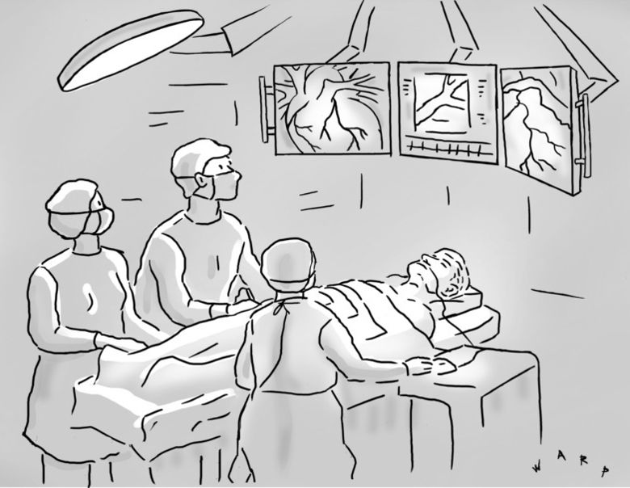
VERA
Why VERA Wins — Competitive Edge
No single agent can achieve
VERA's mission alone.
That's the swarm advantage.
BUILT FOR COLLABORATIVE AGENT SWARMS
■ 4 agents with clear division of responsibilities
■ Emergent capability from collaboration — feedback loop between agents
■ Real-world impact on 600M underserved women
TECHNICAL DIFFERENTIATORS
■ MedGemma — Google's purpose-built medical AI, not generic LLM reasoning
■ Multilingual by design — not an afterthought (EN, HI, TA)
■ Persistent memory across sessions — Companion Agent
■ Feedback loop — Records → Risk Profiler re-scoring
GLOBAL SCALABILITY
Country-agnostic architecture. Scheme data is the only country-specific layer. Add NHS, Medicare equivalents in days, not months.
14

Slide 15
VERA
Partners & Deployment
PRIMARY PARTNER
DEPLOYMENT & PRIVACY
Google Gemini
■ Docker Compose — entire stack in one command
■ PostgreSQL 16 with pgvector — auto-seeded scheme data
■ FastAPI async backend on port 8000
■ Next.js 16 frontend on port 3000
■ No PII stored beyond session
■ GDPR-aligned by design
■ Hardcoded fallbacks — 100% demo reliability
■ MIT Licensed — Open Source
■ Multimodal understanding + multilingual generation
■ Gemini 2.0 Flash for speed, MedGemma for medical accuracy
■ Single API key via Google AI Studio
INFRASTRUCTURE
Vultr
■ Cloud deployment infrastructure
■ Docker containers for backend + database
■ One-command deployment: docker compose up
15

Slide 16
VERA
The Impact — Numbers That Matter
600M
<3s
3
Women skipping screenings globally — VERA's addressable market
Response time per agent step — frictionless experience
Languages at launch: English, Tamil, Hindi — extensible to any
8
4
1
$0
Questions from fear to clarity
Agents, each irreplaceable
Feedback loop — emergent capability
Cost to user — free schemes
Target: 100% demo reliability. Zero crashes during the 7-minute live demo.
Every number represents a woman who deserves to know her risk.
16

Slide 17
02
THE FUTURE
From Prototype to Global Equity
Scaling VERA to every woman, everywhere.
Now — Hackathon + Demo
Milan AI Week 2026
Next — Pilot in India
Partner with screening camps
Future — Global Scale
Every country, every language

Slide 18

AI AGENT OLYMPICS — MILAN AI WEEK 2026
VERA
600 million women. One truth.
TRACK: COLLABORATIVE AGENT SWARMS
GITHUB LINK
MIT Licensed — Open Source
Powered by Google Gemini | Deployed on Vultr

